Slide 1
Digital Portfolio
STUDENT NAME: P.Hariharan
REGISTER NO:222404619
NMID :91738FF1DC4AA80AF2145D3F5ADBCBC3
DEPARTMENT: B.SC COMPUTER SCIENCE WITH AI
COLLEGE : AGURCHAND MANMULL JAIN COLLEGE
UNIVERSITY :MADRAS UNIVERSITY

Slide 2
PROJECT TITLE
My Interactive Portfolio

Slide 3


AGENDA
Problem Statement
Project Overview
End Users
Tools and Technologies
Portfolio design and Layout
Features and Functionality
Results and Screenshots
Conclusion
Github Link
3/21/2024 Annual Review

Slide 4

PROBLEM STATEMENT
Students often struggle to showcase their skills, projects, and certifications in a structured and professional way. Traditional resumes are static and don’t fully highlight practical work or creativity

Slide 5
PROBLEM Solution
To solve this, I created a Digital Interactive Portfolio using HTML, CSS, and JavaScript. It allows me to present my skills, projects, certificates, and contact details in a professional, visually appealing, and easily accessible format. This makes it easier for recruiters and others to understand my abilities beyond a paper resume.

Slide 6

PROJECT OVERVIEW
This project is about creating a personal portfolio website where I can keep all my details in one place. It includes my basic information, resume, certificates, projects, and contact details. The portfolio helps to submit and present my work in a neat and organized way instead of keeping everything separately. It is built using simple web technologies like HTML and CSS so that it is easy to create and update.

Slide 7

WHO ARE THE END USERS?
The end users of this portfolio are mainly:
Teachers & Faculty – to check my resume, certificates, and project details.
Friends & Classmates – to share and showcase my work easily.
Future Recruiters – to quickly understand my skills and achievements.
Myself – to keep all my academic details in one place for future us

Slide 8

TOOLS AND TECHNIQUES
HTML – to design the structure of the portfolio.
CSS – to style and give a modern look.
JavaScript – for basic interactivity.
PowerPoint – to prepare and present the project report.
Laptop/PC & Browser – to develop and run the potfolio.

Slide 9
POTFOLIO DESIGN AND LAYOUT
The portfolio is designed with a navbar for easy navigation (Home, Resume, Certificates, Contact).
Each section is shown in a card-style layout with neat colors and borders.
A dark theme with gradient background is used to give a modern look.
The design is responsive, so it adjusts to desktop and mobile screens.
Simple icons and highlights are added for a professional appearance
9

Slide 10
FEATURES AND FUNCTIONALITY
Features
Simple and clean portfolio website
Multiple sections: Home, Resume, Certificates, Contact
Modern dark theme with gradient background
Navigation bar for easy movement between pages
Card-based design for Resume and Certificates
Uses icons for better look

Slide 11
FEATURES AND FUNCTIONALITY
Functionality
Displays personal and academic details clearly
Shows certificates with title, provider, and date
Resume page highlights education, skills, and projects
Contact page links to email, phone, location, and GitHub
Responsive design works on both desktop and mobile devices

Slide 12
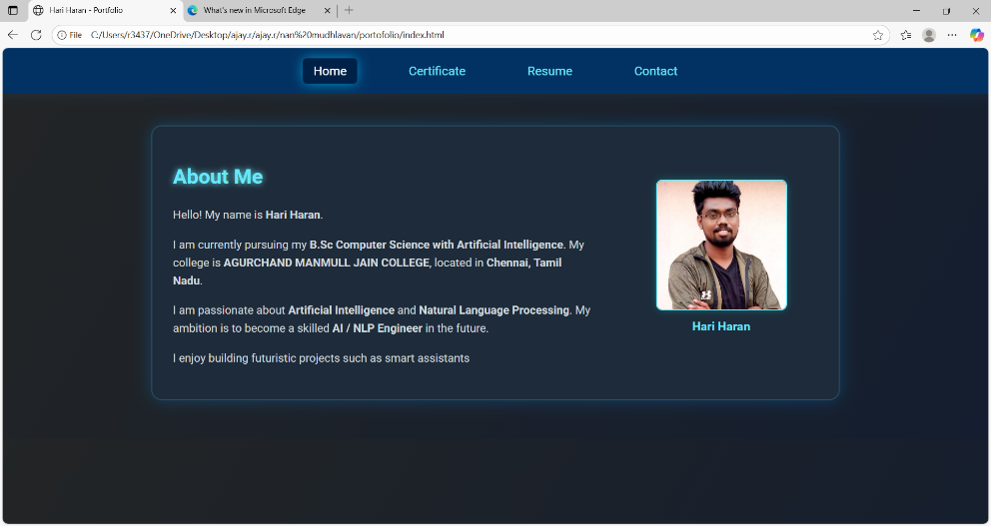
RESULTS AND SCREENSHOTS
Result – Index Page
The Home Page (Index.html) displays my introduction.
It shows my name, course, and college details.
A small “About Me” section explains my interests and goals.
My photo with name is displayed on the right side.
The navigation bar is visible at the top to move to other sections (Resume, Certificates, Contact).
3/21/2024 Annual Review
12

Slide 13
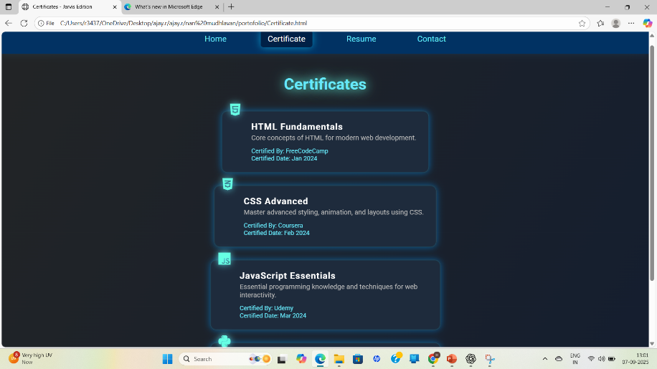
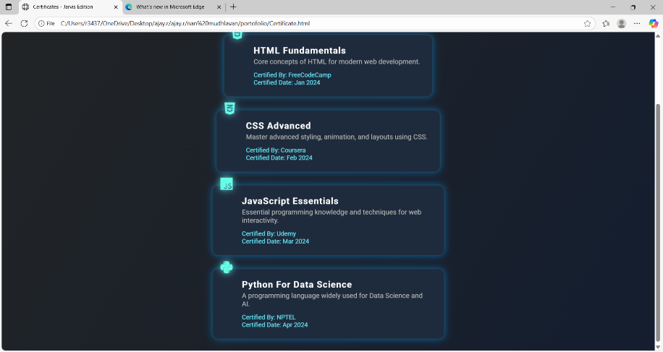
RESULTS AND SCREENSHOTS
Result – Certificate Page
The Certificate Page displays all my completed courses in a card layout.
Each card shows:
Course Title (e.g., HTML Fundamentals, CSS Advanced)
Short Description of the course
Certified By (FreeCodeCamp, Coursera, Udemy, NPTEL)
Certified Date
Icons are used for each course (HTML, CSS, JavaScript, Python).
The page has a modern dark theme with glowing effects.
Certificates are arranged neatly for easy viewing

Slide 14
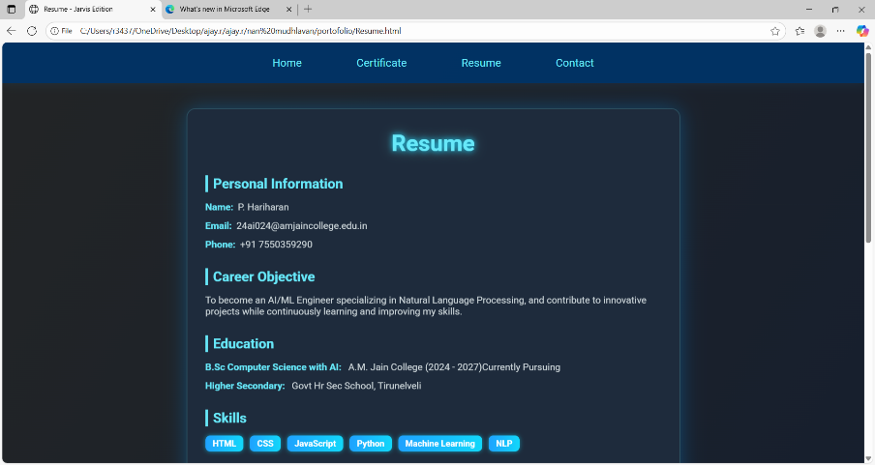
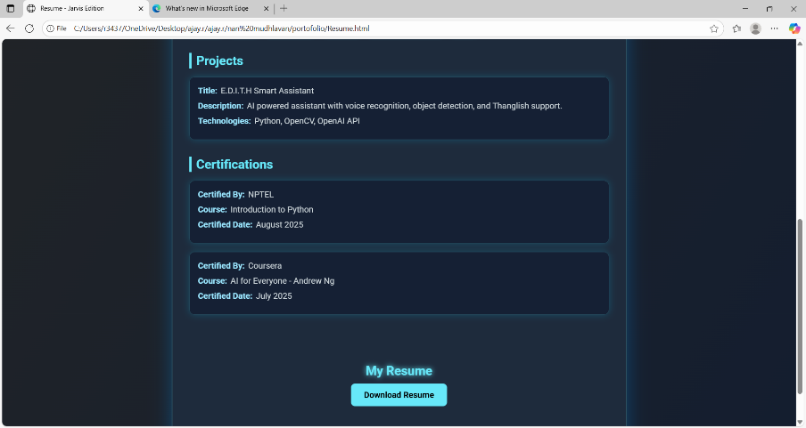
RESULTS AND SCREENSHOTS
Result – Resume Page
The Resume Page shows my complete profile in a structured format.
Sections included are:
Personal Information – Name, Email, Phone number
Career Objective – a short statement about my aim
Education – details of college and school
Skills – listed as tags (HTML, CSS, JavaScript, Python, ML, NLP)
Projects – description of my E.D.I.T.H Smart Assistant project
Certifications – listed with provider and date
The page uses a card-style design with glowing effects and a dark
theme.
Information is neatly organized for easy reading.

Slide 15
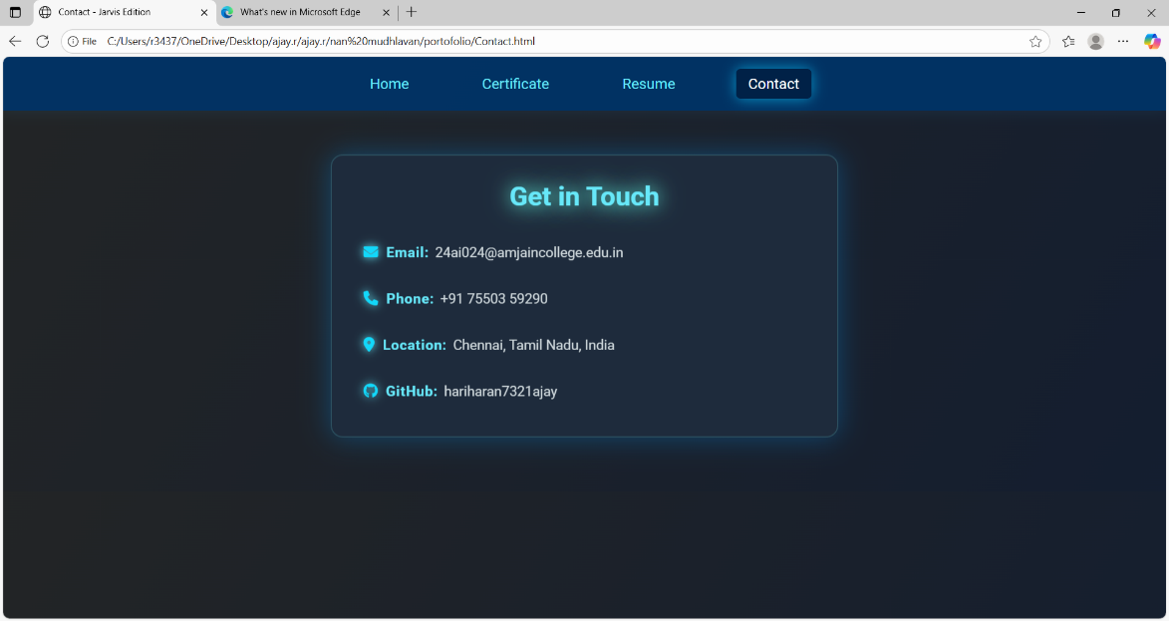
RESULTS AND SCREENSHOTS
Result – Contact Page
The Contact Page displays my communication details.
It includes:
Email ID – 24ai024@amjaincollege.edu.in
Phone Number – +91 75503 59290
Location – Chennai, Tamil Nadu, India (with Google Maps link)
GitHub Profile – hariharan7321ajay
Each detail has an icon (email, phone, map, GitHub) for better clarity.
The design uses a card layout with hover effects to highlight information.
The page helps others easily contact or connect with me.

Slide 16
CONCLUSION
This project helped me learn how to create a personal portfolio website.
I practiced using HTML and CSS to design and style web pages.
The portfolio brings together my resume, certificates, projects, and contact details in one place.
It is simple, clear, and easy to use for students, teachers, and recruiters.
Overall, this project improved my web development skills and gave me a useful platform to showcase my work.
16

Slide 17
Github link
I uploaded my portfolio project on GitHub.
This helps me to store and share my code online.
Teachers and friends can easily see my project.
In future, I can also update my project here.
https://hariharan7321ajay.github.io/nan-mudhalvan/
This is my Github Link

Slide 18
Thank you
🙏 Thank you for viewing my presentation.
I learned a lot by doing this project.
It helped me improve my skills and organize my work.
I am happy to share my portfolio with you.
✨ Thank You! ✨

